Slide 1



MAGSR Males
GA
38
Tyson

Slide 2
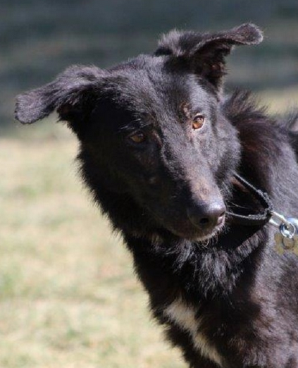
CAYDEN
Gender: Male
Breed: German Shepherd Dog
Approximate Age: 1 year 1 month
Color: Black
Current Size: 50 lbs
Housebroken: No
Obedience Trained: No
Living with: Kennel
History: Abuse/Neglect
Good With Kids: Unknown
Good With Cats: Unlikely
Other Dogs OK: Yes, big dogs only
Cayden is making good progress. He was much easier to get set up to go than he has been the last few times I have taken him out. This guy really does love treats (he also seems to recognize that most volunteers have something special in their pocket for him). Once outside the kennel, Cayden was much more receptive to touch; however, I was careful putting on the prong and we used positive reinforcement with food to solidify the deal. Cayden moved about carefully today. He was more willing to come up to volunteers for treats and was much easier to handle with the prong collar. Once Cayden started getting more vocal and a little agitated today, we went back to the inside area. He definitely knows his way back into the kennel. Overall, Cayden was easy to return to his run and had a pretty good day.

Slide 3
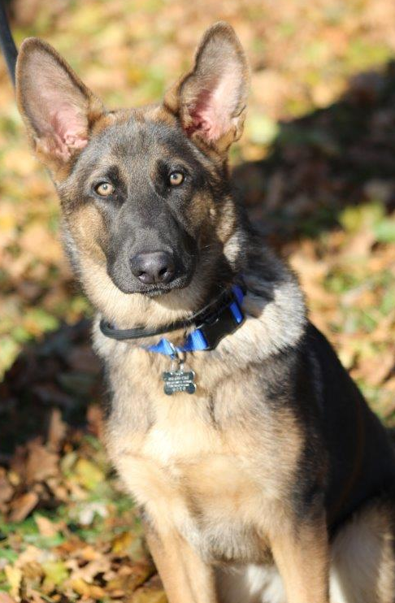
DIESEL
Gender: Male
Breed: German Shepherd Dog
Approximate Age: 8 months 1 week Color: Black & Tan
Current Size: 57 lbs
Housebroken: Unknown
Obedience Trained: No
Living with: Kennel
History: Owner Surrender
Good With Kids: Unknown
Good With Cats: Unknown
Other Dogs OK: Yes
This handsome pup has not had the best start in life. He has lived outdoors on a chain, not taught manners, leash skills or training. Thankfully someone got him out of the situation and surrendered him to us. He is one busy boy, he will jump on you, he will mouth you, he will pull you on the leash. But with training, structure and direction he will learn to be well mannered. He is still just a puppy at 8 months old, so expect high energy, playfulness, chewing things and all of the antics that come with having a young dog. You absolutely need the time to provide him with daily exercise and structure, at this age he is no couch potato.

Slide 4
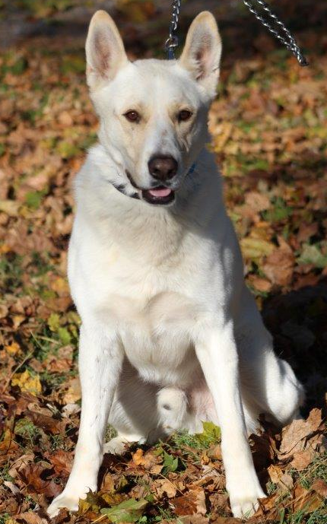
GEIST
Gender: Male
Breed: German Shepherd Mix
Approximate Age: 2 years 2 months Color: White
Current Size: 77 lbs
Housebroken: Unknown
Obedience Trained: No
Living with: Kennel
History: Other Rescue
Good With Kids: Unknown
Good With Cats: Unknown
Other Dogs OK: Unknown
Geist is a male German Shepherd mix with a beautiful white coat. He is new to the rescue, but a super sweet guy. Geist is lovely with the female dogs, but not so great with male dogs. He's simply a nice fella that prefers the ladies to himself. Geist is good with humans and loving. Like all of our dogs, Geist will benefit from standard obedience work to help him be the best gentleman he can be.

Slide 5
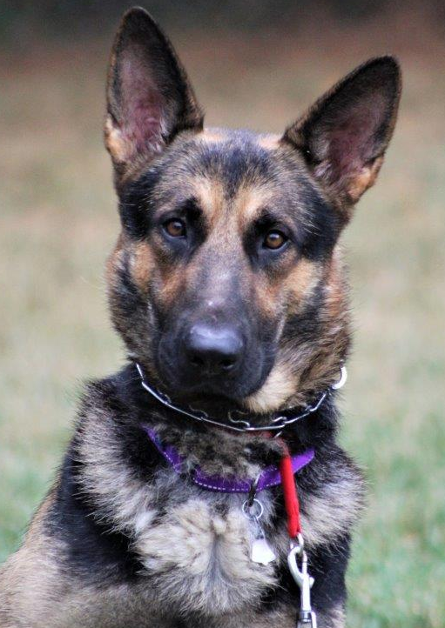
JOHNNY
Gender: Male
Breed: German Shepherd Dog
Approximate Age: 2 years 1 week
Color: Black & Tan
Current Size: 80 lbs
Housebroken: Likely
Obedience Trained: Partially
Living with: Kennel
History: Shelter
Good With Kids: No
Good With Cats: Unknown
Other Dogs OK: Yes
Johnny came to us from a shelter, we have no history for him. Since arriving in our care, he has been a little nervous and a little unsure with his new surroundings. Johnny is a kind gentle soul and is very gentle with his handler. He can take a little time to get comfortable with strangers. He enjoys belly rubs, being with his people, staying by his human's side, and will look to his handler for guidance. Johnny is a wonderful boy and anyone would be lucky to have him.

Slide 6
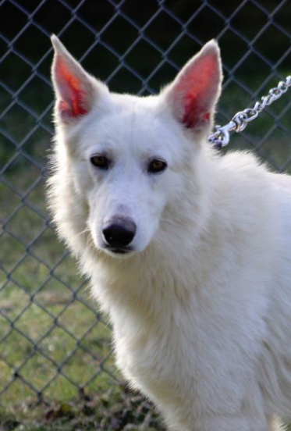
LUTHER
Gender: Male
Breed: German Shepherd Dog
Approximate Age: 3 years 1 month
Color: White
Current Size: 75 lbs
Housebroken: No
Obedience Trained: No
Living with: Kennel
History: Abuse/Neglect
Good With Kids: Unknown
Good With Cats: Unknown
Other Dogs OK: Yes
One of the largest puppy mill busts found hundreds of German Shepherd's living in absolute filth and in horrendous conditions. No adequate shelter, lacking food and clean water is how these dogs were left to live, many for years. The urgent call was made and MAGSR knew we had to take in as many as possible. We now have 38 dogs that have a multitude of medical needs that we are addressing, and they need to learn to trust humans. All dogs are scared, but our volunteers and vets will get them on their road to recovery. An undertaking of this size for an all-volunteer rescue is quite a task, but one we are meeting it head on. We are committed to providing everything they need, not only medically, but emotionally. We will provide the path for these dogs to have a better life.

Slide 7
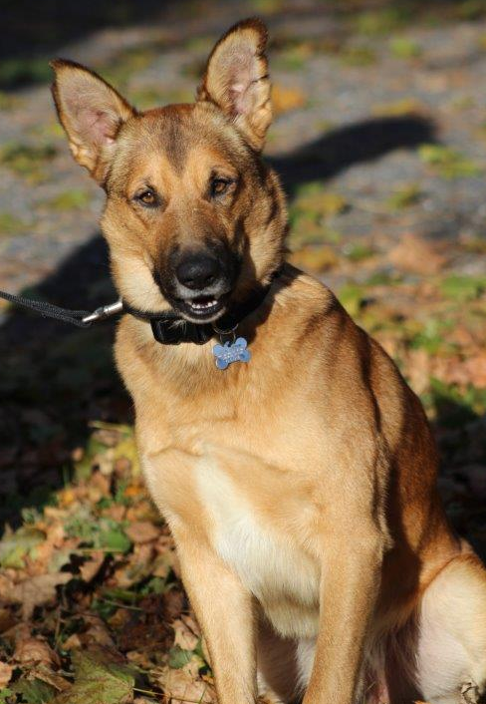
REGIS
Gender: Male
Breed: German Shepherd Mix
Approximate Age: 1 year 20 hours Color: Fawn & Black
Current Size: 70 lbs
Housebroken: Unknown
Obedience Trained: No
Living with: Kennel
History: Shelter
Good With Kids: Unknown
Good With Cats: Unknown
Other Dogs OK: Yes, Females Only
Regis was surrendered to a shelter as his family moved and could not take him with them. He is new to us so we are still getting to know him. He does best with female dogs and prefers them over male dogs. He loves belly rubs, rolling over on his back for a good scratching. Regis will benefit greatly from obedience training, learning good manners and what is expected of him.

Slide 8
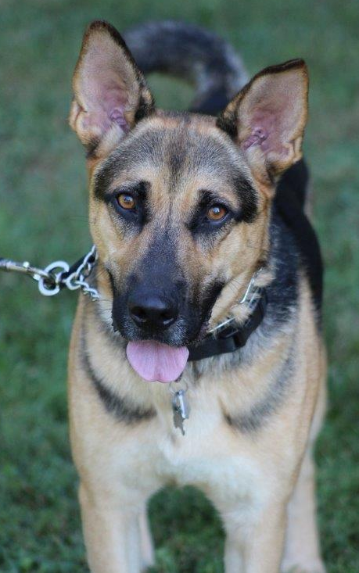
RIPTIDE
Gender: Male
Breed: German Shepherd Mix
Approximate Age: 2 years 10 months Color: Black & Tan
Current Size: 70 lbs
Housebroken: Yes
Obedience Trained: Partially
Living with: Kennel
History: Shelter
Good With Kids: Yes, older kids
Good With Cats: Unknown
Other Dogs OK: Yes
Unfortunately, Riptide has been returned to us as his adopter fractured her ankle and is non weight bearing. With Riptide’s high energy, she was not able to provide his daily exercise requirements. Riptide was also not doing well with one of their teenage twin daughters. He was fine with one of them. He has been to obedience training, but his new family is required to complete training with him. Training is a great way to learn more about each other, how to work together and create a bond.

Slide 9
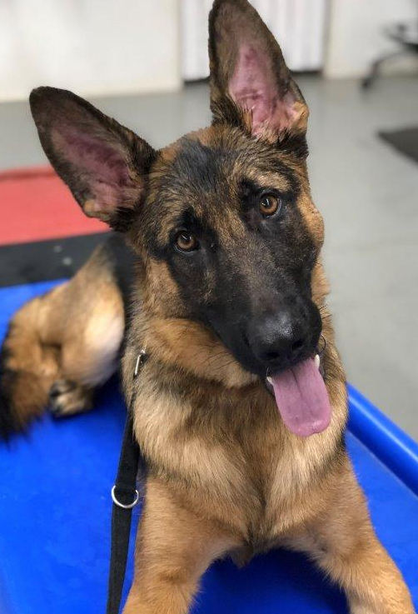
TEAK
Gender: Male
Breed: German Shepherd Dog
Approximate Age: 1 year 2 months Color: Black & Tan
Current Size: 67 lbs
Housebroken: Yes
Obedience Trained: No
Living with: Foster
History: Owner Surrender
Good With Kids: Yes, older kids
Good With Cats: Unknown
Other Dogs OK: Yes
Teak came to us as his prior family did not have the time for a young, energetic GSD. Unfortunately Teak has not been well socialized with people outside of his prior immediate family. For this reason Teak is scared and skittish of new people, new places, sights and sounds. Our volunteers are giving Teak time to settle in and get use to all that is new to him. He will be starting a training program which will help with not only socialization, but also build his confidence. He will require a GSD experienced family that will continue with his training, socialization and confidence building. He did live with older children and another dog in his prior home.

Slide 10
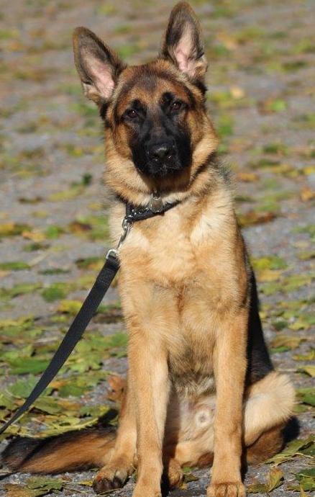
TYSON
Gender: Male
Breed: German Shepherd Dog
Approximate Age: 9 months 3 days Color: Black & Tan
Current Size: 62 lbs
Housebroken: Unknown
Obedience Trained: No
Living with: Kennel
History: Owner Surrender
Good With Kids: Unknown
Good With Cats: Unknown
Other Dogs OK: Yes
Tyson is another product of someone getting a dog then not having time for him. Yes dogs need your time, your devotion, your commitment to them for their lifetime. It needs to be a well thought out, realistic decision before getting a pet. Tyson is now looking for the family who has thought their decision through and will commit to him for his lifetime. Yes he needs training and daily exercise. Yes he will try your patience at times and get into things he shouldn’t, but this is where his family comes in. He needs to be taught good manners and he needs obedience training, which his family needs to provide. Be sure you have the time and patience for years to come.

Slide 11
MAGSR Females
GA
38

Slide 12
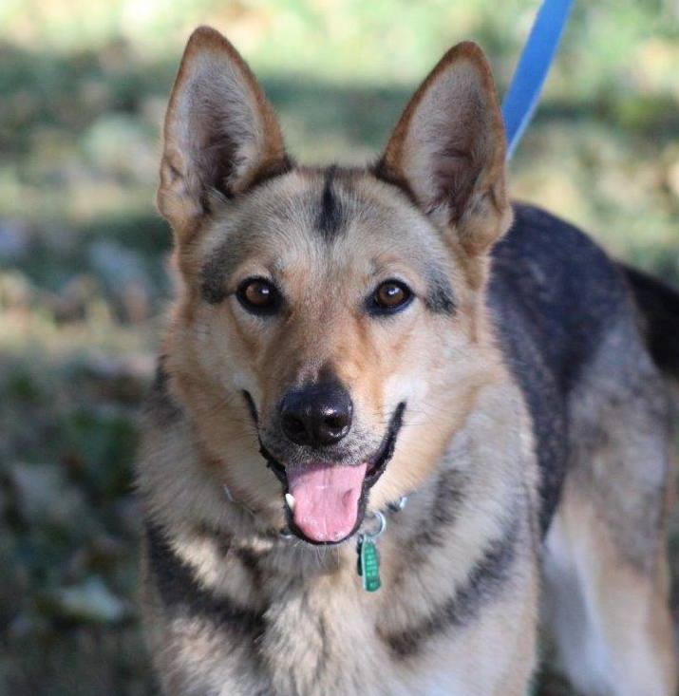
BAILEY
Gender: Female
Breed: German Shepherd Dog
Approximate Age: 2 years 1 week Color: Black & Tan
Current Size: 60 lbs
Housebroken: Unknown
Obedience Trained: No
Living with: Foster
History: Other Rescue
Good With Kids: Yes
Good With Cats: No
Other Dogs OK: Yes
Bebee
Bailey was surrendered as her family had no time for her and it shows in her lack training and manners. She is such a beautiful, friendly girl that just needs a family to teach her good canine manners. A good training program will teach her jumping up is not acceptable and will also help with her leash skills. Given the opportunity, Bailey will crawl up into her human's lap for loving - she's very sweet. Bailey has some energy to burn that ong walks and a good a game of fetch will help with. Exercising both the body and brain will be very beneficial for her.

Slide 13
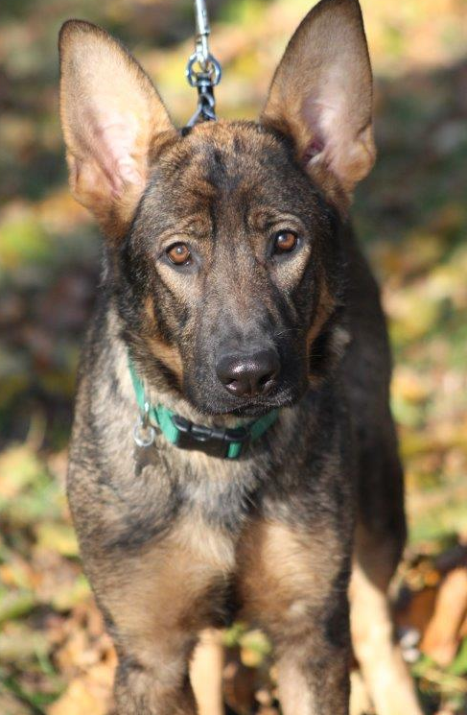
BEBEE
Gender: Female
Breed: German Shepherd Dog
Approximate Age: 11 months 5 days Color: Sable
Current Size: 77 lbs
Housebroken: Unknown
Obedience Trained: No
Living with: Kennel
History: Owner Surrender
Good With Kids: Yes
Good With Cats: Likely
Other Dogs OK: Yes
Bebee was surrendered to us as her former person did not have time for her. Due to the lack of time and commitment Bebee was left to do as she wished. A young dog without training, direction, exercise and guidance can find themselves in unsafe situations. Bebee found herself in one those situations when she was hit by car. Luckily she did not sustain serious injuries. She is now in the safety of rescue starting to learn good manners and being properly cared for. Bebee is somewhat nervous meeting new people, but once she is comfortable with you she is a sweetheart. We were told she lived with another dog and cats, and has spent time with a toddler. As she is new to us, we are still learning more about her.

Slide 14
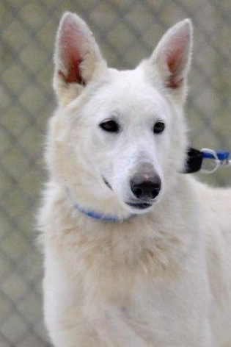
CESSNA
Gender: Female
Breed: German Shepherd Dog
Approximate Age: 2 years 1 month
Color: White
Current Size: 56 lbs
Housebroken: No
Obedience Trained: No
Living with: Kennel
History: Abuse/Neglect
Good With Kids: Unknown
Good With Cats: Unknown
Other Dogs OK: Yes
One of the largest puppy mill busts found hundreds of German Shepherd's living in absolute filth and in horrendous conditions. No adequate shelter, lacking food and clean water is how these dogs were left to live, many for years. The urgent call was made and MAGSR knew we had to take in as many as possible. We now have 38 dogs that have a multitude of medical needs that we are addressing, and they need to learn to trust humans. All dogs are scared, but our volunteers and vets will get them on their road to recovery. An undertaking of this size for an all-volunteer rescue is quite a task, but one we are meeting it head on. We are committed to providing everything they need, not only medically, but emotionally. We will provide the path for these dogs to have a better life.

Slide 15
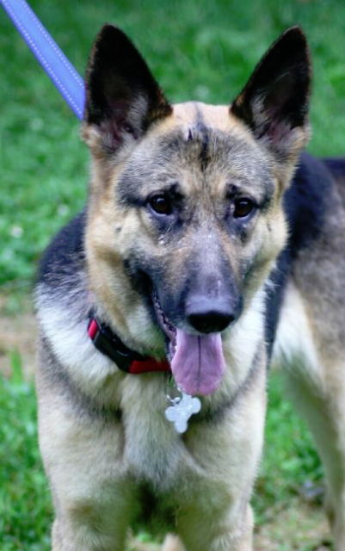
GRACE
Gender: Female
Breed: German Shepherd Dog
Approximate Age: 4 years 3 months
Color: Black & Tan
Current Size: 58 lbs
Housebroken: Yes
Obedience Trained: No
Living with: Foster
History: Shelter
Good With Kids: Older kids, over 16
Good With Cats: Likely
Other Dogs OK: Yes
Grace has completed her heartworm treatment and is now heartworm free. Once Grace bonds with her human and gets comfortable, she becomes protective of her space. This can be easily managed by putting her away in a secure room and/or crate when people come to the home. She will also benefit from a strong leader, who has prior experience with the breed, and who will provide appropriate correction and training. Grace will not meet families with children under the age of 16. Grace is very excited to be able to run and play just like any other dog once again. Now she’s even more interested in finding her forever home and family to share her love with. Could that be your family?

Slide 16
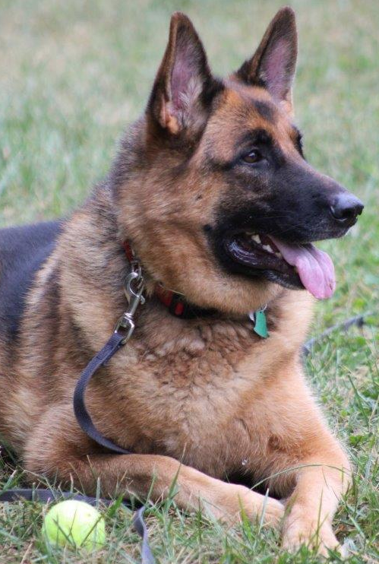
LEIA
Gender: Female
Breed: German Shepherd Dog
Approximate Age: 4 years 1 month Color: Black & Tan
Current Size: 98 lbs
Housebroken: Yes
Obedience Trained: No
Living with: Foster
History: Shelter
Good With Kids: Yes
Good With Cats: Yes
Other Dogs OK: Yes, Large Males only
Leia was surrendered to a shelter as her military dad was deployed overseas. She is a large very friendly girl. Leia enjoys her humans and gets along well with other dogs. She is overweight so a diet and exercise are in order. Leia has shown our volunteers that she's up for a game of fetch with a tennis ball and running around and playing with her human.

Slide 17
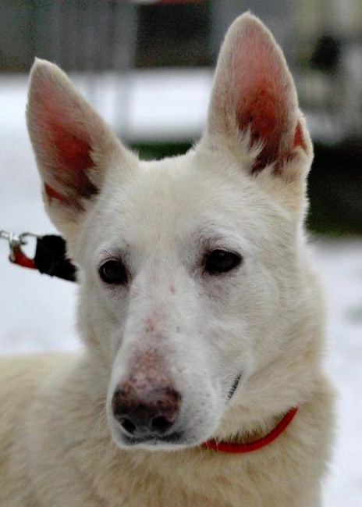
LEONA
Gender: Female
Breed: German Shepherd Dog
Approximate Age: 2 years 1 month
Color: White
Current Size: 64 lbs
Housebroken: No
Obedience Trained: No
Living with: Kennel
History: Abuse/Neglect
Good With Kids: Unknown
Good With Cats: Unknown
Other Dogs OK: Yes
One of the largest puppy mill busts found hundreds of German Shepherd's living in absolute filth and in horrendous conditions. No adequate shelter, lacking food and clean water is how these dogs were left to live, many for years. The urgent call was made and MAGSR knew we had to take in as many as possible. We now have 38 dogs that have a multitude of medical needs that we are addressing, and they need to learn to trust humans. All dogs are scared, but our volunteers and vets will get them on their road to recovery. An undertaking of this size for an all-volunteer rescue is quite a task, but one we are meeting it head on. We are committed to providing everything they need, not only medically, but emotionally. We will provide the path for these dogs to have a better life.

Slide 18
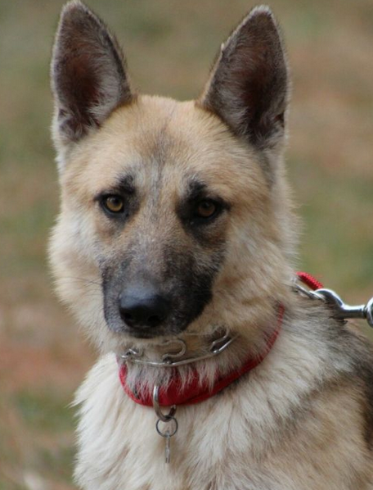
MILLA
Gender: Female
Breed: German Shepherd Dog
Approximate Age: 2 years 1 month
Color: Black & Tan
Current Size: 53 lbs
Housebroken: No
Obedience Trained: No
Living with: Kennel
History: Abuse/Neglect
Good With Kids: Unknown
Good With Cats: Unknown
Other Dogs OK: Yes
One of the largest puppy mill busts found hundreds of German Shepherd's living in absolute filth and in horrendous conditions. No adequate shelter, lacking food and clean water is how these dogs were left to live, many for years. The urgent call was made and MAGSR knew we had to take in as many as possible. We now have 38 dogs that have a multitude of medical needs that we are addressing, and they need to learn to trust humans. All dogs are scared, but our volunteers and vets will get them on their road to recovery. An undertaking of this size for an all-volunteer rescue is quite a task, but one we are meeting it head on. We are committed to providing everything they need, not only medically, but emotionally. We will provide the path for these dogs to have a better life.

Slide 19
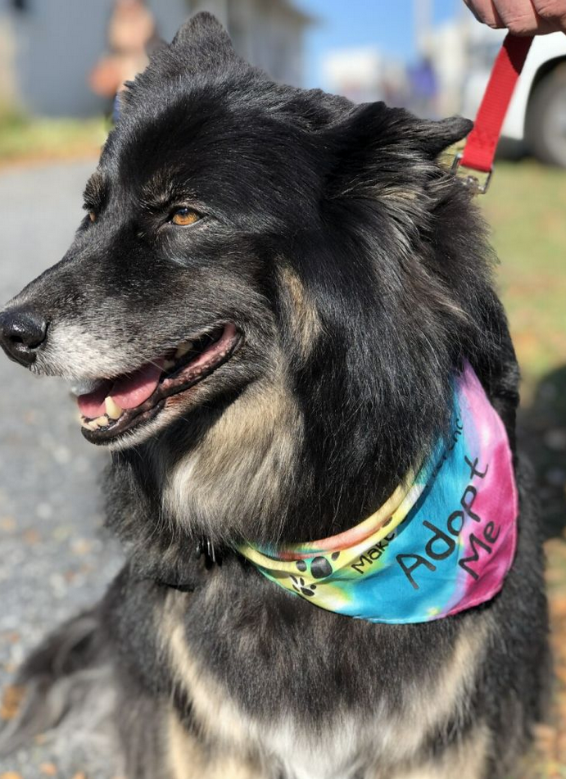
RILEY
Gender: Female
Breed: German Shepherd Mix
Approximate Age: 7 years 6 months Color: Black & Tan
Current Size: 72 lbs
Housebroken: Unknown
Obedience Trained: No
Living with: Foster
History: Owner Surrender
Good With Kids: Yes
Good With Cats: Unknown
Other Dogs OK: Yes
Riley’s prior family gave her up after having her for 6 years as they no longer wanted her. As you can imagine losing her family is upsetting. She just arrived in our care so we are taking the time to get to know her better. Riley is hopeful that her next family will commit to her for her lifetime and not just toss her aside. She is over weight, so a diet and exercise are in order. Her beautiful long coat is matted and dirty but she will be enjoying a spa day.

Slide 20
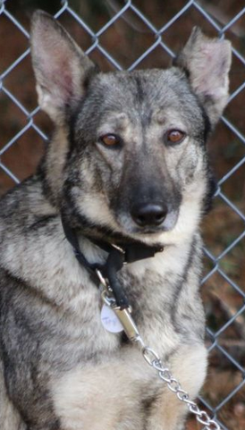
TAYSON
Gender: Female
Breed: German Shepherd Dog
Approximate Age: 2 years 1 month
Color: Sable
Current Size: 66 lbs
Housebroken: No
Obedience Trained: No
Living with: Kennel
History: Abuse/Neglect
Good With Kids: Unknown
Good With Cats: Unknown
Other Dogs OK: Yes
One of the largest puppy mill busts found hundreds of German Shepherd's living in absolute filth and in horrendous conditions. No adequate shelter, lacking food and clean water is how these dogs were left to live, many for years. The urgent call was made and MAGSR knew we had to take in as many as possible. We now have 38 dogs that have a multitude of medical needs that we are addressing, and they need to learn to trust humans. All dogs are scared, but our volunteers and vets will get them on their road to recovery. An undertaking of this size for an all-volunteer rescue is quite a task, but one we are meeting it head on. We are committed to providing everything they need, not only medically, but emotionally. We will provide the path for these dogs to have a better life.

