Slide 1
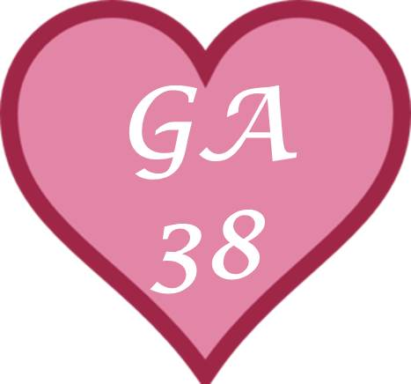
MAGSR Males
GA
38

Slide 2
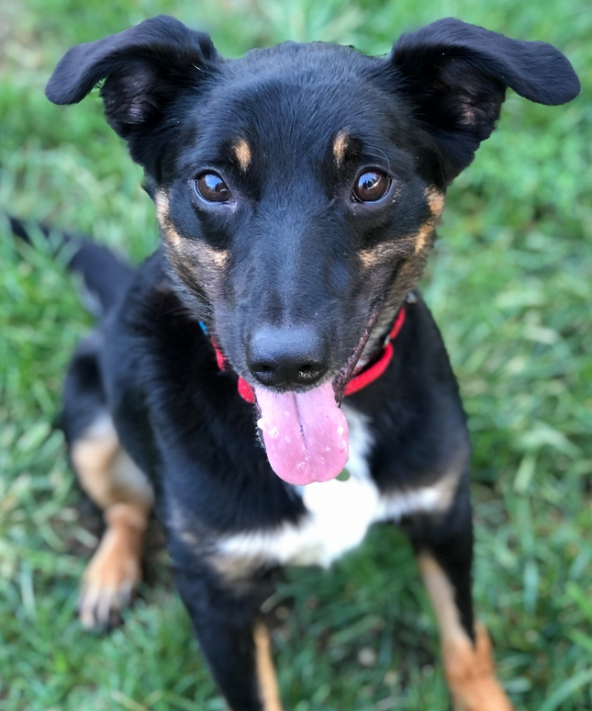
ARCHIE
Gender: Male Breed: German Shepherd Mix Approximate Age: 3 years
Color: black and tan Current Size: 45 Housebroken: Unknown Obedience Trained: No Living with: Foster
History: Abuse/Neglect
Good With Kids: Yes Good With Cats: Unlikely Other Dogs OK: Yes
Archie came to us after being confiscated for cruelty. Witnesses saw his former owner beating him with a metal baton and the police were called. Archie sustained trauma to his head, which left an open wound to his head along with a fractured frontal sinus cavity. He also has fractured teeth which are being extracted. There were old scars possibly from earlier abuse. Archie received immediate medical treatment for his injuries. Although Archie is a mix breed we could not leave him behind. We welcomed him into MAGSR with open arms as an honorary GSD. He seems to have recovered both physically and mentally from traumatic event. Archie is a fun, friendly, high energize boy. He loves to romp around and play a good game of fetch. He will require a family that can match his energy level in order for him to receive the exercise he will need. Archie is needing a family that will treat him with kindness, that will provide him with a safe and stable home, lots of love and care.

Slide 3
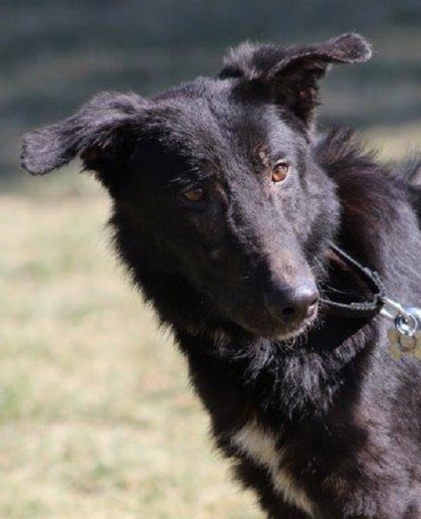
CAYDEN
Gender: Male Breed: German Shepherd Dog Approximate Age: 1 year 1 month
Color: Black Current Size: 50 lbs Housebroken: No Obedience Trained: No
Living with: Kennel
History: Abuse/Neglect
Good With Kids: Unknown Good With Cats: Unlikely Other Dogs OK: Yes, big dogs only
Cayden is making good progress. He was much easier to get set up to go than he has been the last few times I have taken him out. This guy really does love treats (he also seems to recognize that most volunteers have something special in their pocket for him). Once outside the kennel, Cayden was much more receptive to touch; however, I was careful putting on the prong and we used positive reinforcement with food to solidify the deal. Cayden moved about carefully today. He was more willing to come up to volunteers for treats and was much easier to handle with the prong collar. Once Cayden started getting more vocal and a little agitated today, we went back to the inside area. He definitely knows his way back into the kennel. Overall, Cayden was easy to return to his run and had a pretty good day.

Slide 4
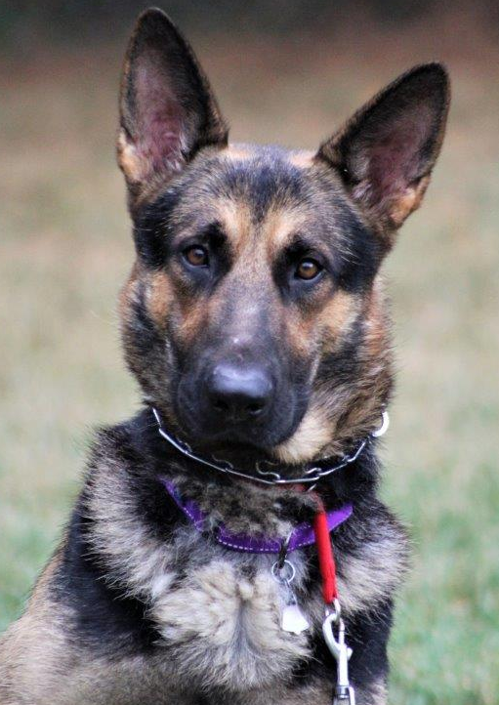
JOHNNY
Gender: Male Breed: German Shepherd Dog Approximate Age: 2 years 1 week
Color: Black & Tan Current Size: 80 lbs Housebroken: Likely Obedience Trained: Partially Living with: Kennel
History: Shelter
Good With Kids: No Good With Cats: Unknown Other Dogs OK: Yes
Johnny came to us from a shelter, we have no history for him. Since arriving in our care, he has been a little nervous and a little unsure with his new surroundings. Johnny is a kind gentle soul and is very gentle with his handler. He can take a little time to get comfortable with strangers. He enjoys belly rubs, being with his people, staying by his human's side, and will look to his handler for guidance. Johnny is a wonderful boy and anyone would be lucky to have him.

Slide 5
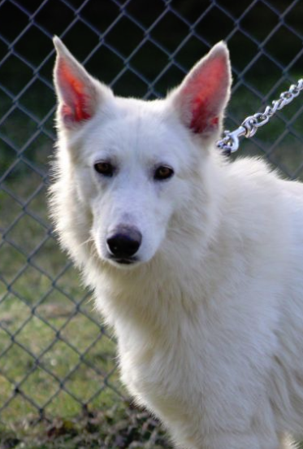
LUTHER
Gender: Male Breed: German Shepherd Dog Approximate Age: 3 years 1 month
Color: White Current Size: 75 lbs Housebroken: No Obedience Trained: No Living with: Kennel
History: Abuse/Neglect
Good With Kids: Unknown Good With Cats: Unknown Other Dogs OK: Yes
One of the largest puppy mill busts found hundreds of German Shepherd's living in absolute filth and in horrendous conditions. No adequate shelter, lacking food and clean water is how these dogs were left to live, many for years. The urgent call was made and MAGSR knew we had to take in as many as possible. We now have 38 dogs that have a multitude of medical needs that we are addressing, and they need to learn to trust humans. All dogs are scared, but our volunteers and vets will get them on their road to recovery. An undertaking of this size for an all-volunteer rescue is quite a task, but one we are meeting it head on. We are committed to providing everything they need, not only medically, but emotionally. We will provide the path for these dogs to have a better life.

Slide 6
MAGSR Females
GA
38

Slide 7
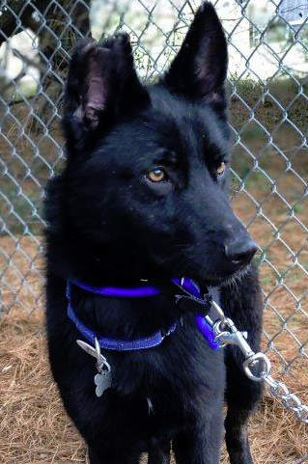
AYAYU
Gender: Female Breed: German Shepherd Dog Approximate Age: 2 years 1 month
Color: black Current Size: 43 lbs Housebroken: No Obedience Trained: No Living with: Kennel
History: Abuse/Neglect
Good With Kids: No Good With Cats: Unknown Other Dogs OK: Yes
One of the largest puppy mill busts found hundreds of German Shepherd's living in absolute filth and in horrendous conditions. No adequate shelter, lacking food and clean water is how these dogs were left to live, many for years. The urgent call was made and MAGSR knew we had to take in as many as possible. We now have 38 dogs that have a multitude of medical needs that we are addressing, and they need to learn to trust humans. All dogs are scared, but our volunteers and vets will get them on their road to recovery. An undertaking of this size for an all-volunteer rescue is quite a task, but one we are meeting it head on. We are committed to providing everything they need, not only medically, but emotionally. We will provide the path for these dogs to have a better life.

Slide 8
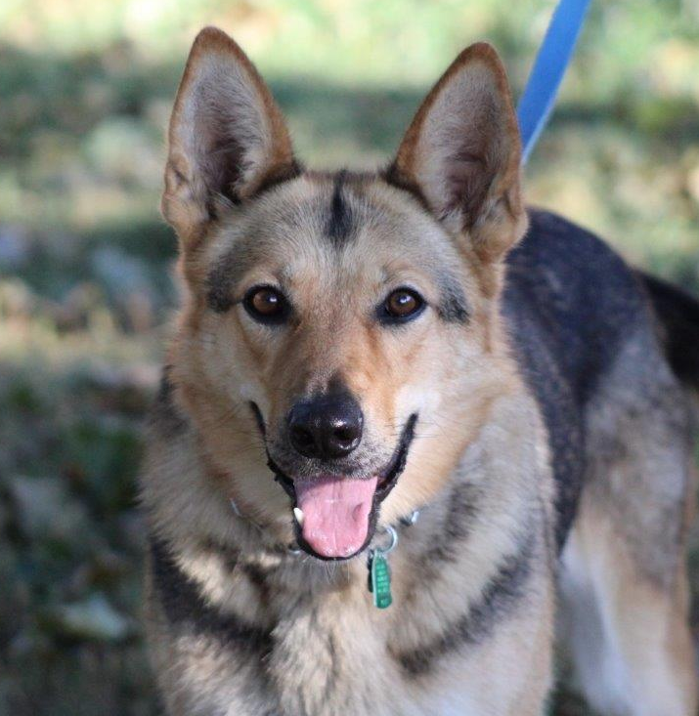
BAILEY
Gender: Female Breed: German Shepherd Dog Approximate Age: 2 years 1 week Color: Black & Tan Current Size: 60 lbs Housebroken: Unknown Obedience Trained: No Living with: Foster
History: Other Rescue
Good With Kids: Yes Good With Cats: No Other Dogs OK: Yes
Bailey was surrendered as her family had no time for her and it shows in her lack training and manners. She is such a beautiful, friendly girl that just needs a family to teach her good canine manners. A good training program will teach her jumping up is not acceptable and will also help with her leash skills. Given the opportunity, Bailey will crawl up into her human's lap for loving - she's very sweet. Bailey has some energy to burn that ong walks and a good a game of fetch will help with. Exercising both the body and brain will be very beneficial for her.

Slide 9
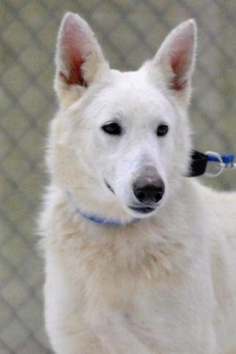
CESSNA
Gender: Female
Breed: German Shepherd Dog
Approximate Age: 2 years 1 month
Color: White
Current Size: 56 lbs
Housebroken: No
Obedience Trained: No
Living with: Kennel
History: Abuse/Neglect
Good With Kids: Unknown
Good With Cats: Unknown
Other Dogs OK: Yes
One of the largest puppy mill busts found hundreds of German Shepherd's living in absolute filth and in horrendous conditions. No adequate shelter, lacking food and clean water is how these dogs were left to live, many for years. The urgent call was made and MAGSR knew we had to take in as many as possible. We now have 38 dogs that have a multitude of medical needs that we are addressing, and they need to learn to trust humans. All dogs are scared, but our volunteers and vets will get them on their road to recovery. An undertaking of this size for an all-volunteer rescue is quite a task, but one we are meeting it head on. We are committed to providing everything they need, not only medically, but emotionally. We will provide the path for these dogs to have a better life.

Slide 10
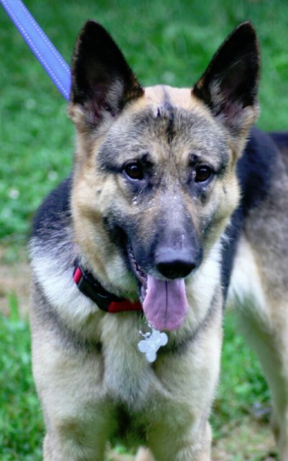
GRACE
Gender: Female
Breed: German Shepherd Dog
Approximate Age: 4 years 3 months
Color: Black & Tan
Current Size: 58 lbs
Housebroken: Yes
Obedience Trained: No
Living with: Foster
History: Shelter
Good With Kids: Older kids, over 16
Good With Cats: Likely
Other Dogs OK: Yes
Grace has completed her heartworm treatment and is now heartworm free. Once Grace bonds with her human and gets comfortable, she becomes protective of her space. This can be easily managed by putting her away in a secure room and/or crate when people come to the home. She will also benefit from a strong leader, who has prior experience with the breed, and who will provide appropriate correction and training. Grace will not meet families with children under the age of 16. Grace is very excited to be able to run and play just like any other dog once again. Now she’s even more interested in finding her forever home and family to share her love with. Could that be your family?

Slide 11
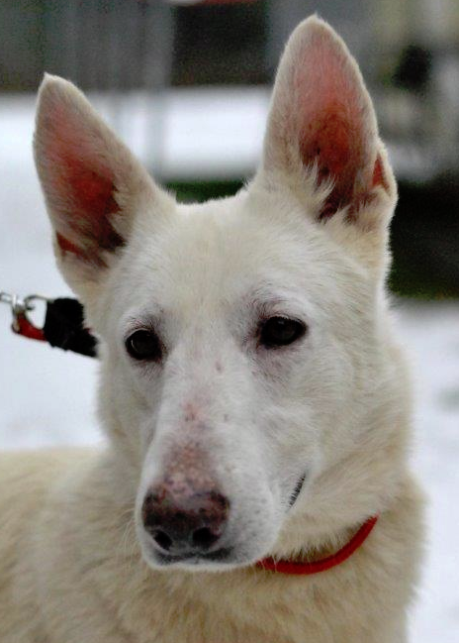
LEONA
Gender: Female
Breed: German Shepherd Dog
Approximate Age: 2 years 1 month
Color: White
Current Size: 64 lbs
Housebroken: No
Obedience Trained: No
Living with: Kennel
History: Abuse/Neglect
Good With Kids: Unknown
Good With Cats: Unknown
Other Dogs OK: Yes
One of the largest puppy mill busts found hundreds of German Shepherd's living in absolute filth and in horrendous conditions. No adequate shelter, lacking food and clean water is how these dogs were left to live, many for years. The urgent call was made and MAGSR knew we had to take in as many as possible. We now have 38 dogs that have a multitude of medical needs that we are addressing, and they need to learn to trust humans. All dogs are scared, but our volunteers and vets will get them on their road to recovery. An undertaking of this size for an all-volunteer rescue is quite a task, but one we are meeting it head on. We are committed to providing everything they need, not only medically, but emotionally. We will provide the path for these dogs to have a better life.

Slide 12
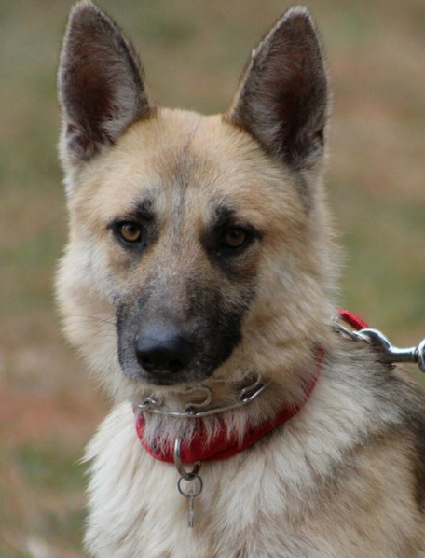
MILLA
Gender: Female
Breed: German Shepherd Dog
Approximate Age: 2 years 1 month
Color: Black & Tan
Current Size: 53 lbs
Housebroken: No
Obedience Trained: No
Living with: Kennel
History: Abuse/Neglect
Good With Kids: Unknown
Good With Cats: Unknown
Other Dogs OK: Yes
One of the largest puppy mill busts found hundreds of German Shepherd's living in absolute filth and in horrendous conditions. No adequate shelter, lacking food and clean water is how these dogs were left to live, many for years. The urgent call was made and MAGSR knew we had to take in as many as possible. We now have 38 dogs that have a multitude of medical needs that we are addressing, and they need to learn to trust humans. All dogs are scared, but our volunteers and vets will get them on their road to recovery. An undertaking of this size for an all-volunteer rescue is quite a task, but one we are meeting it head on. We are committed to providing everything they need, not only medically, but emotionally. We will provide the path for these dogs to have a better life.

Slide 13
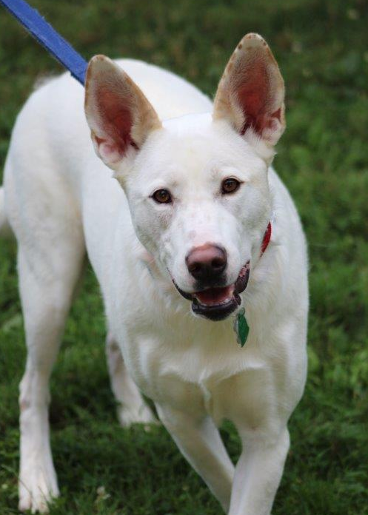
RIANA
Gender: Female Breed: German Shepherd Dog Approximate Age: 2 years 1 month Color: White Current Size: 62 lbs Housebroken: Yes Obedience Trained: No Living with: Foster
History: Abuse/Neglect
Good With Kids: Yes Good With Cats: Likely Other Dogs OK: Yes
Riana is settling right in to her foster home. Riana had a number of teeth extracted that were fractured and not good. Riana loves to play and romp around with the resident dogs. Even though Riana was in an unhealthy relationship with her prior owner, she has bounced back and is happy, healthy, friendly & affectionate, bouncy, playful and full of tail wags.
Update: Riana is proving every day to her foster parents how excellent and perfect she is. She is potty trained, crate trained, sits for attention, walks like a dream on the leash and is incredibly loving and snuggly. She is a dog who wants to please and could fit in with a wide variety of families. Riana does great with the resident dog(s) and matches in energy level and play style. She’s good in the car and in public places and is the perfect lady. Riana is living with a cat and is curious and a little confused. If your home may be a match for her, ask to meet her.

Slide 14
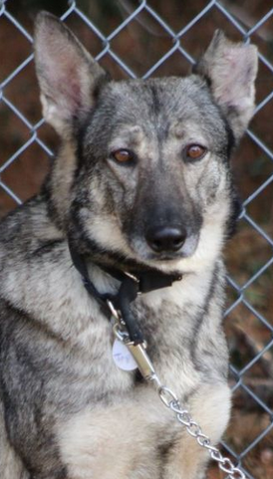
TAYSON
Gender: Female
Breed: German Shepherd Dog
Approximate Age: 2 years 1 month
Color: Sable
Current Size: 66 lbs
Housebroken: No
Obedience Trained: No
Living with: Kennel
History: Abuse/Neglect
Good With Kids: Unknown
Good With Cats: Unknown
Other Dogs OK: Yes
One of the largest puppy mill busts found hundreds of German Shepherd's living in absolute filth and in horrendous conditions. No adequate shelter, lacking food and clean water is how these dogs were left to live, many for years. The urgent call was made and MAGSR knew we had to take in as many as possible. We now have 38 dogs that have a multitude of medical needs that we are addressing, and they need to learn to trust humans. All dogs are scared, but our volunteers and vets will get them on their road to recovery. An undertaking of this size for an all-volunteer rescue is quite a task, but one we are meeting it head on. We are committed to providing everything they need, not only medically, but emotionally. We will provide the path for these dogs to have a better life.

